Slide 1
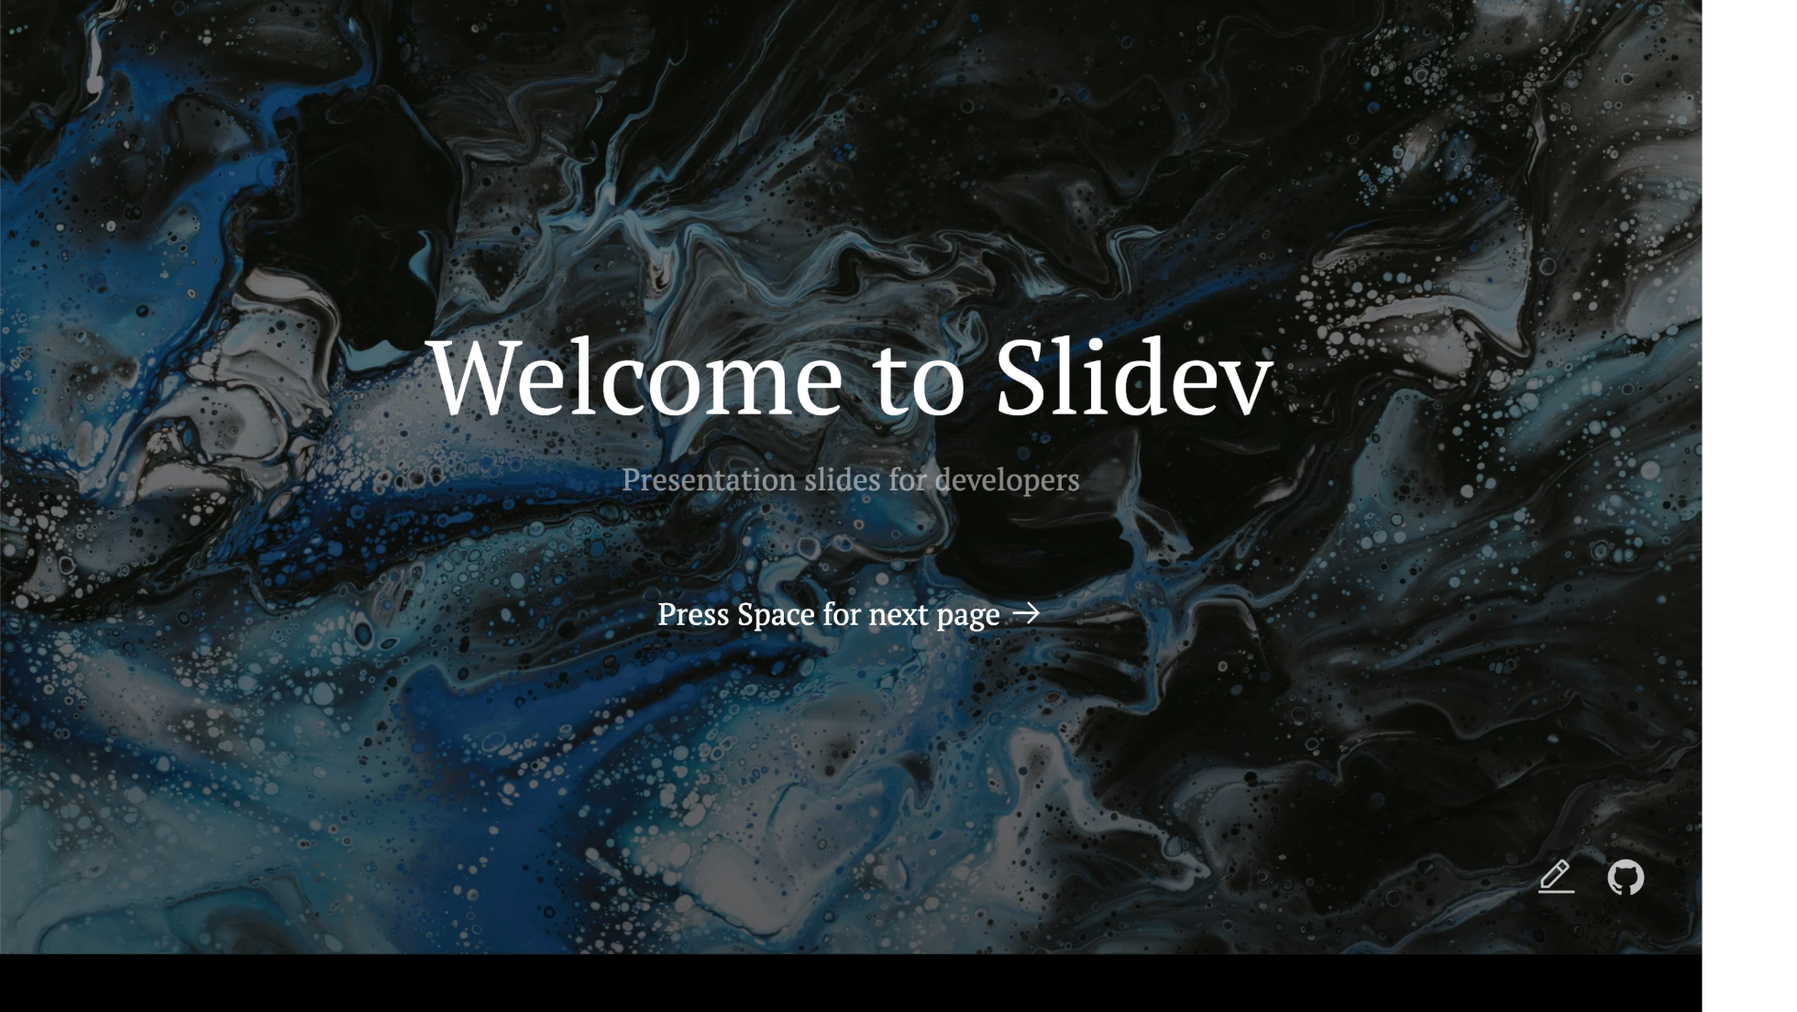
Notes:
The last comment block of each slide will be treated as slide notes. It will be visible and editable in Presenter Mode along with the slide. [Read more in the docs](https://sli.dev/guide/syntax.html#notes)

Slide 2
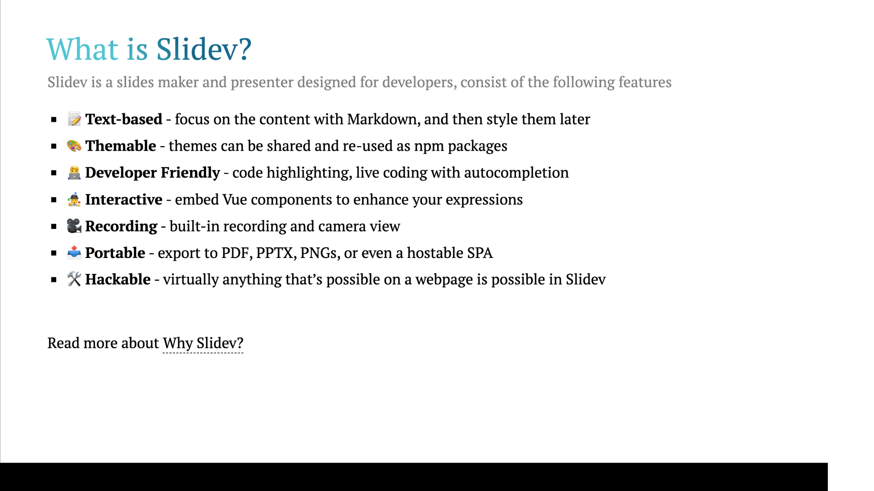
Notes:
Here is another comment.

Slide 3
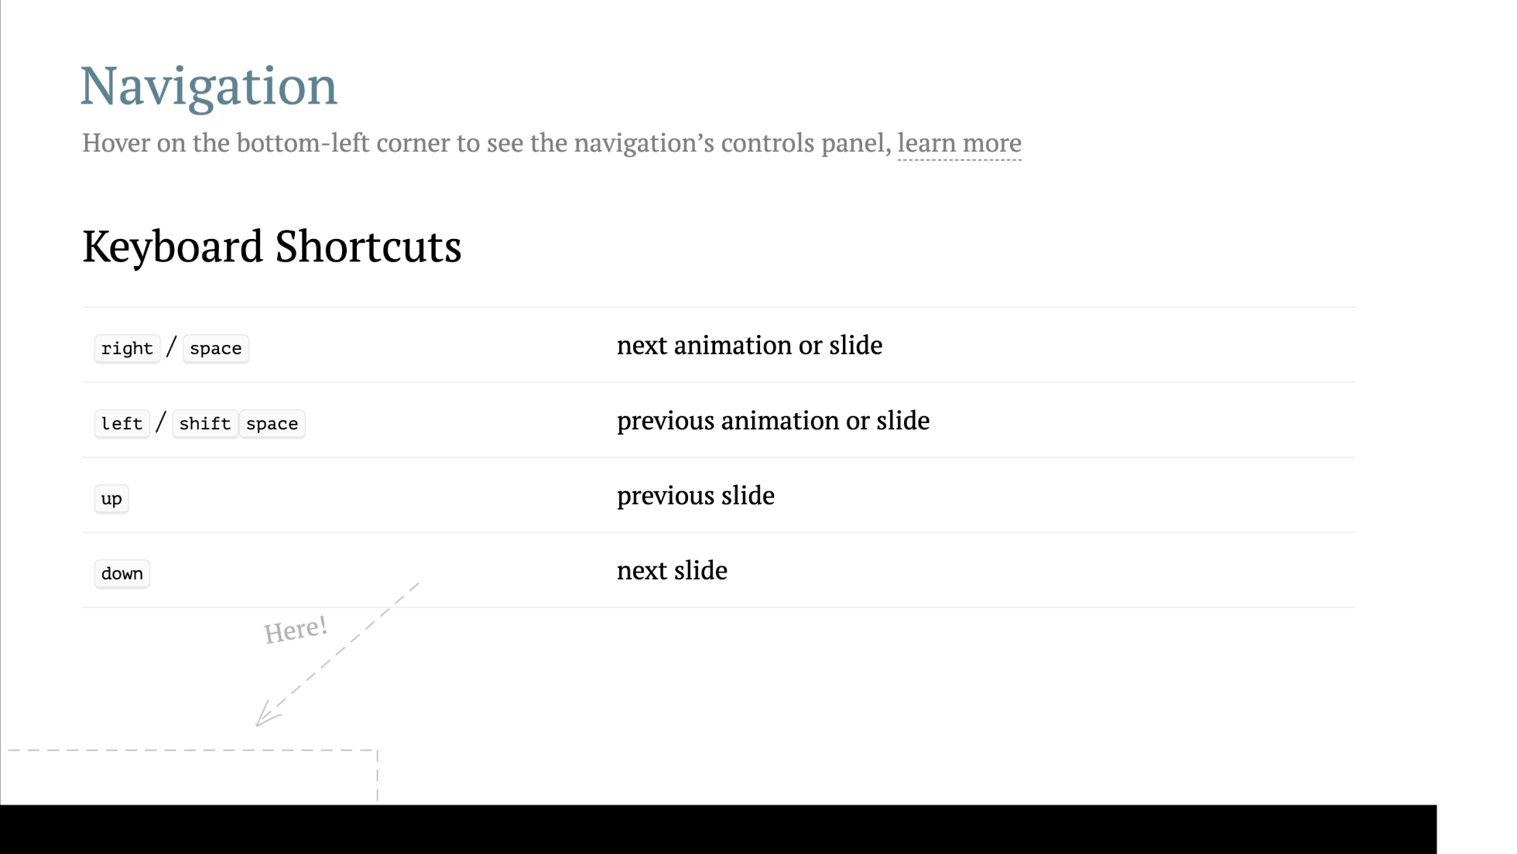

Slide 4
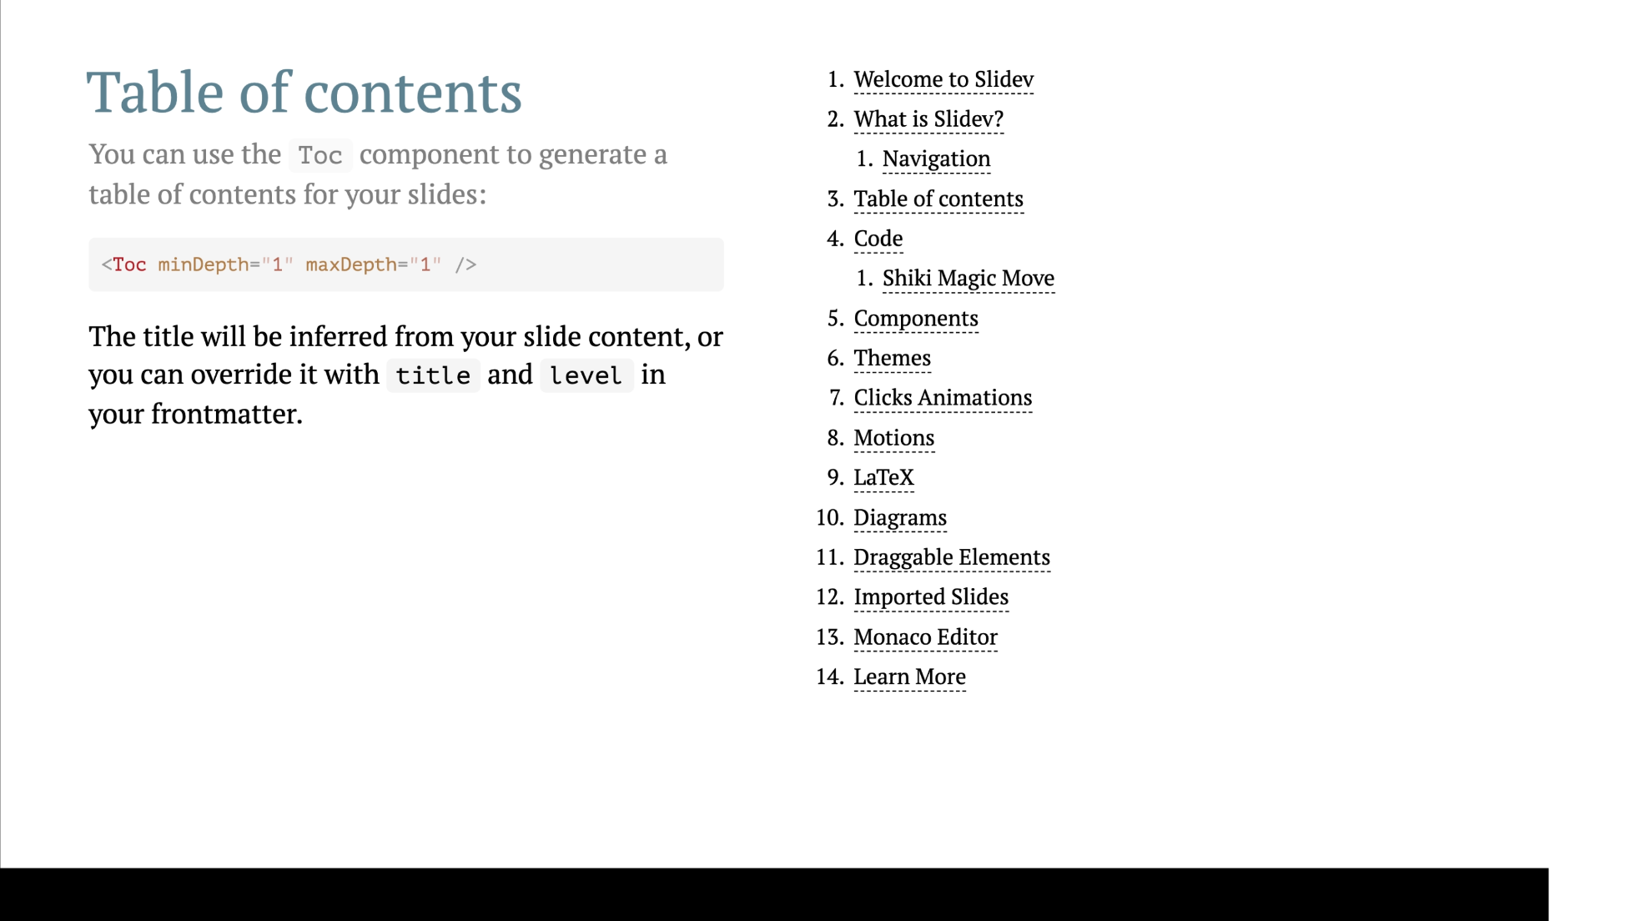

Slide 5

Notes:
Notes can also sync with clicks [click] This will be highlighted after the first click [click] Highlighted with `count = ref(0)` [click:3] Last click (skip two clicks)

Slide 6
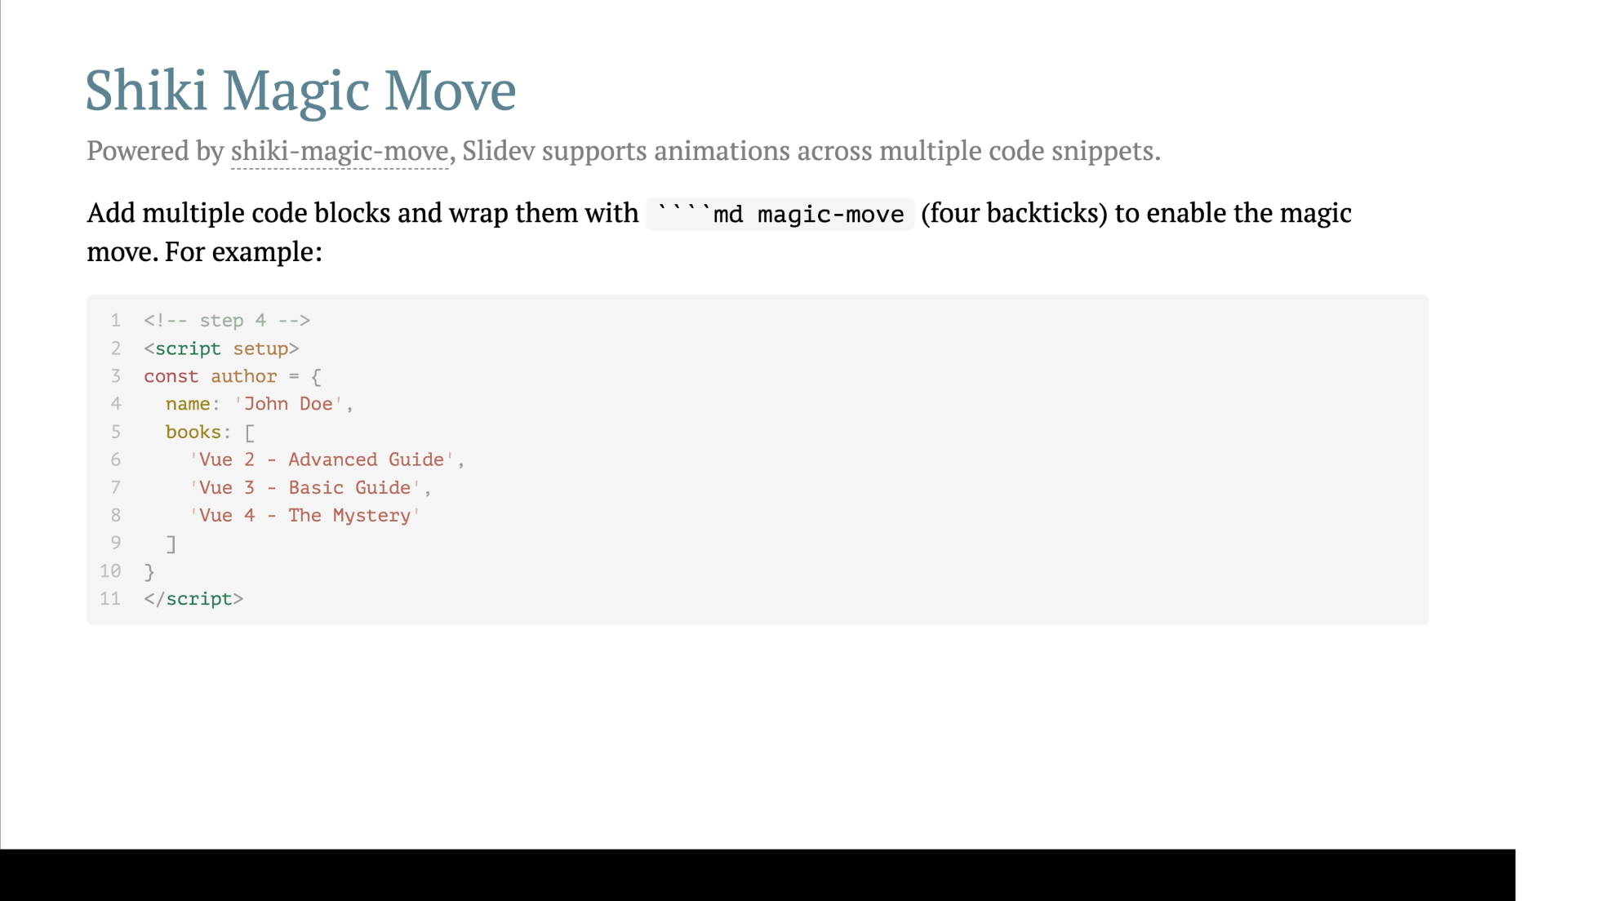

Slide 7
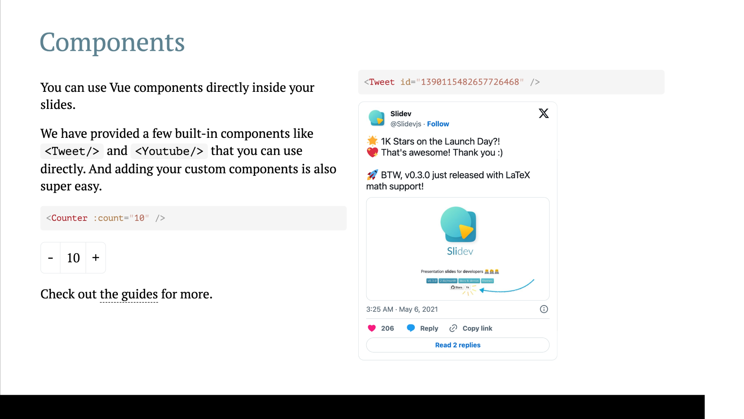
Notes:
Presenter note with **bold**, *italic*, and ~~striked~~ text. Also, HTML elements are valid: <div class="flex w-full"> <span style="flex-grow: 1;">Left content</span> <span>Right content</span> </div>

Slide 8
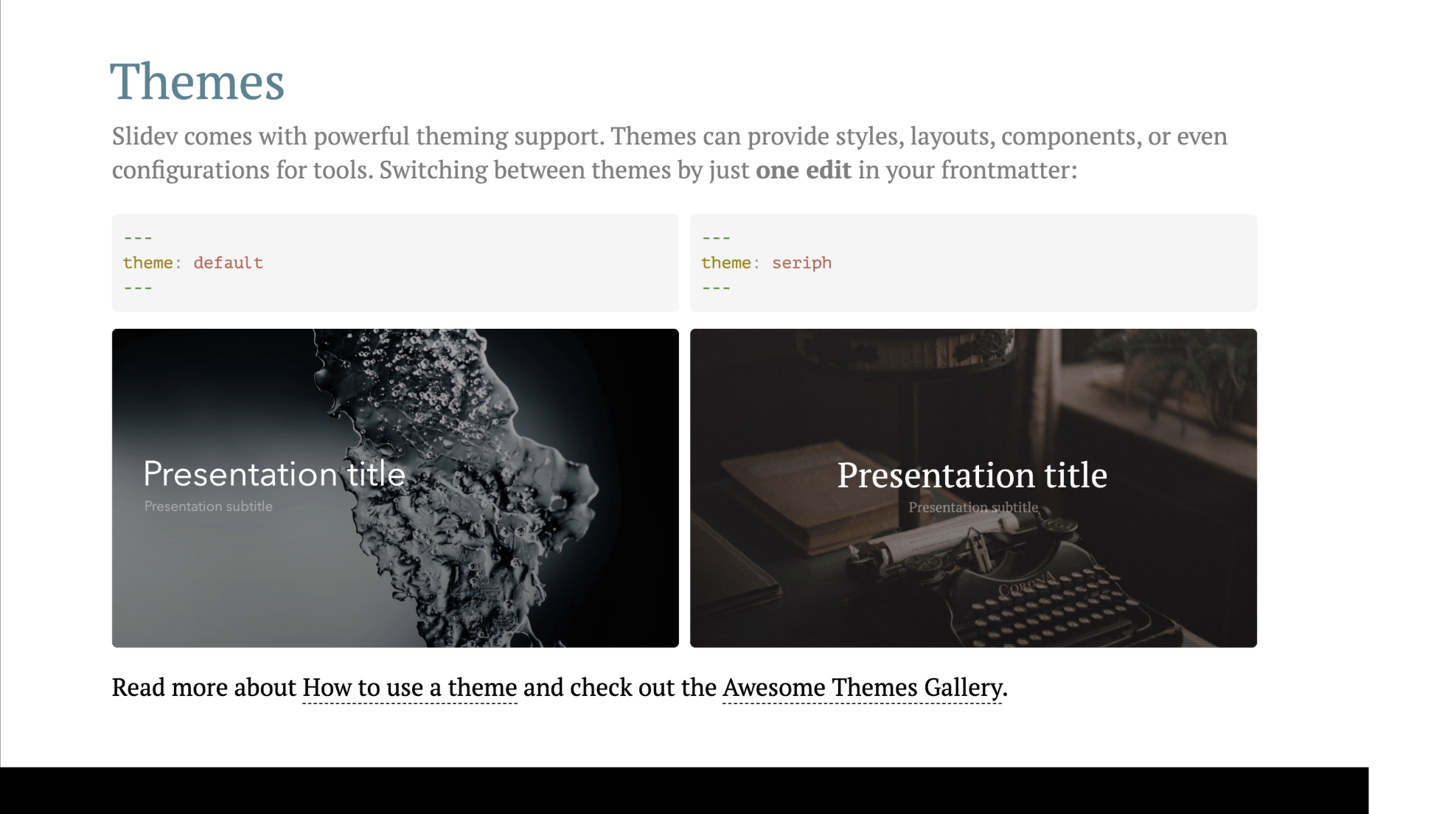

Slide 9
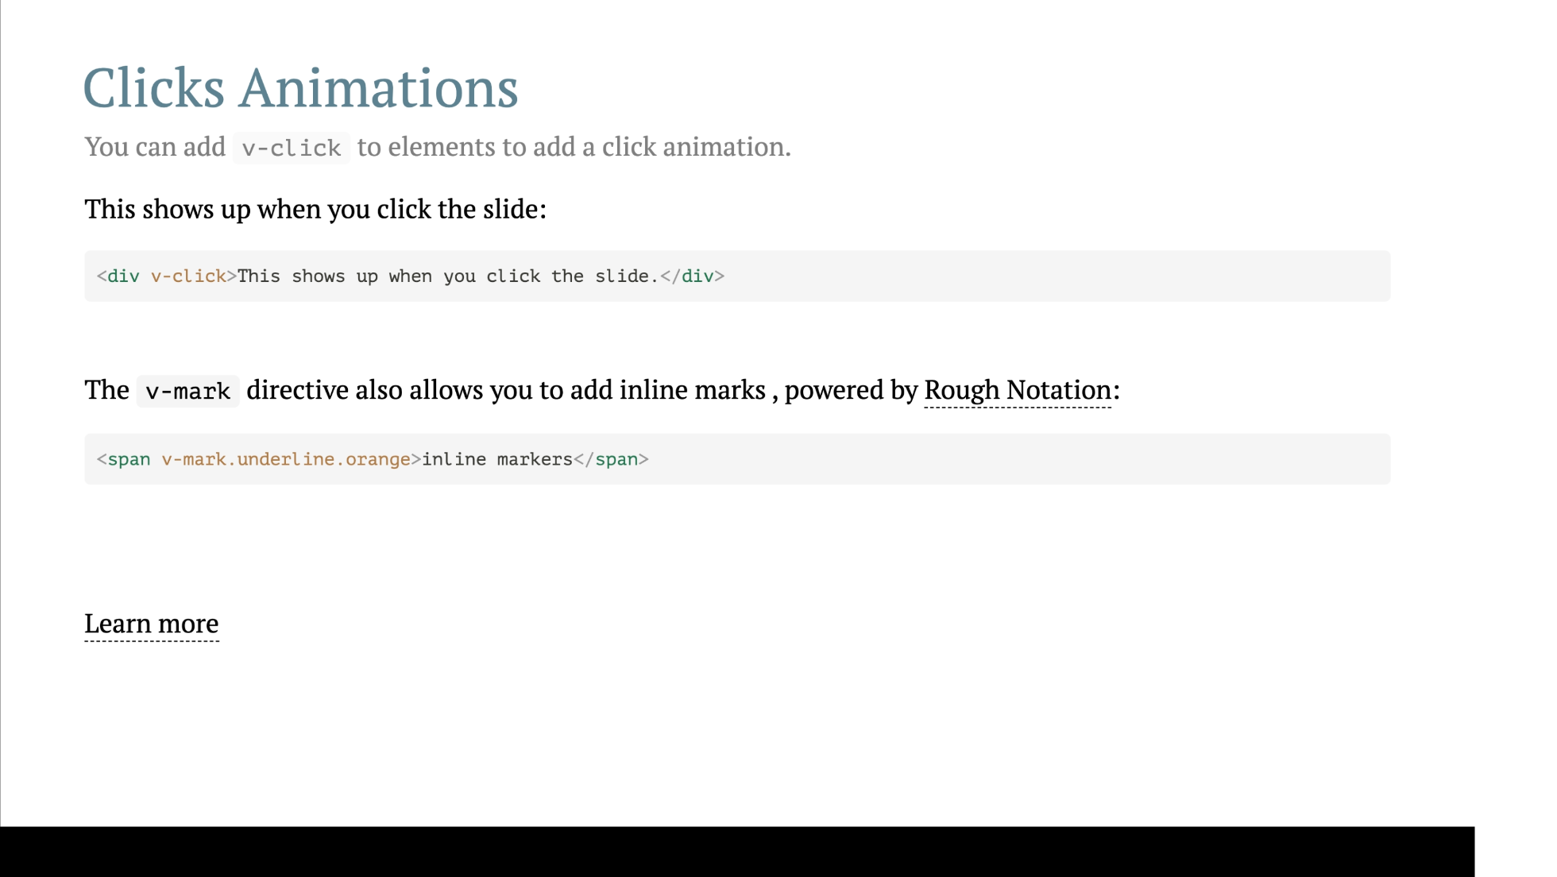

Slide 10
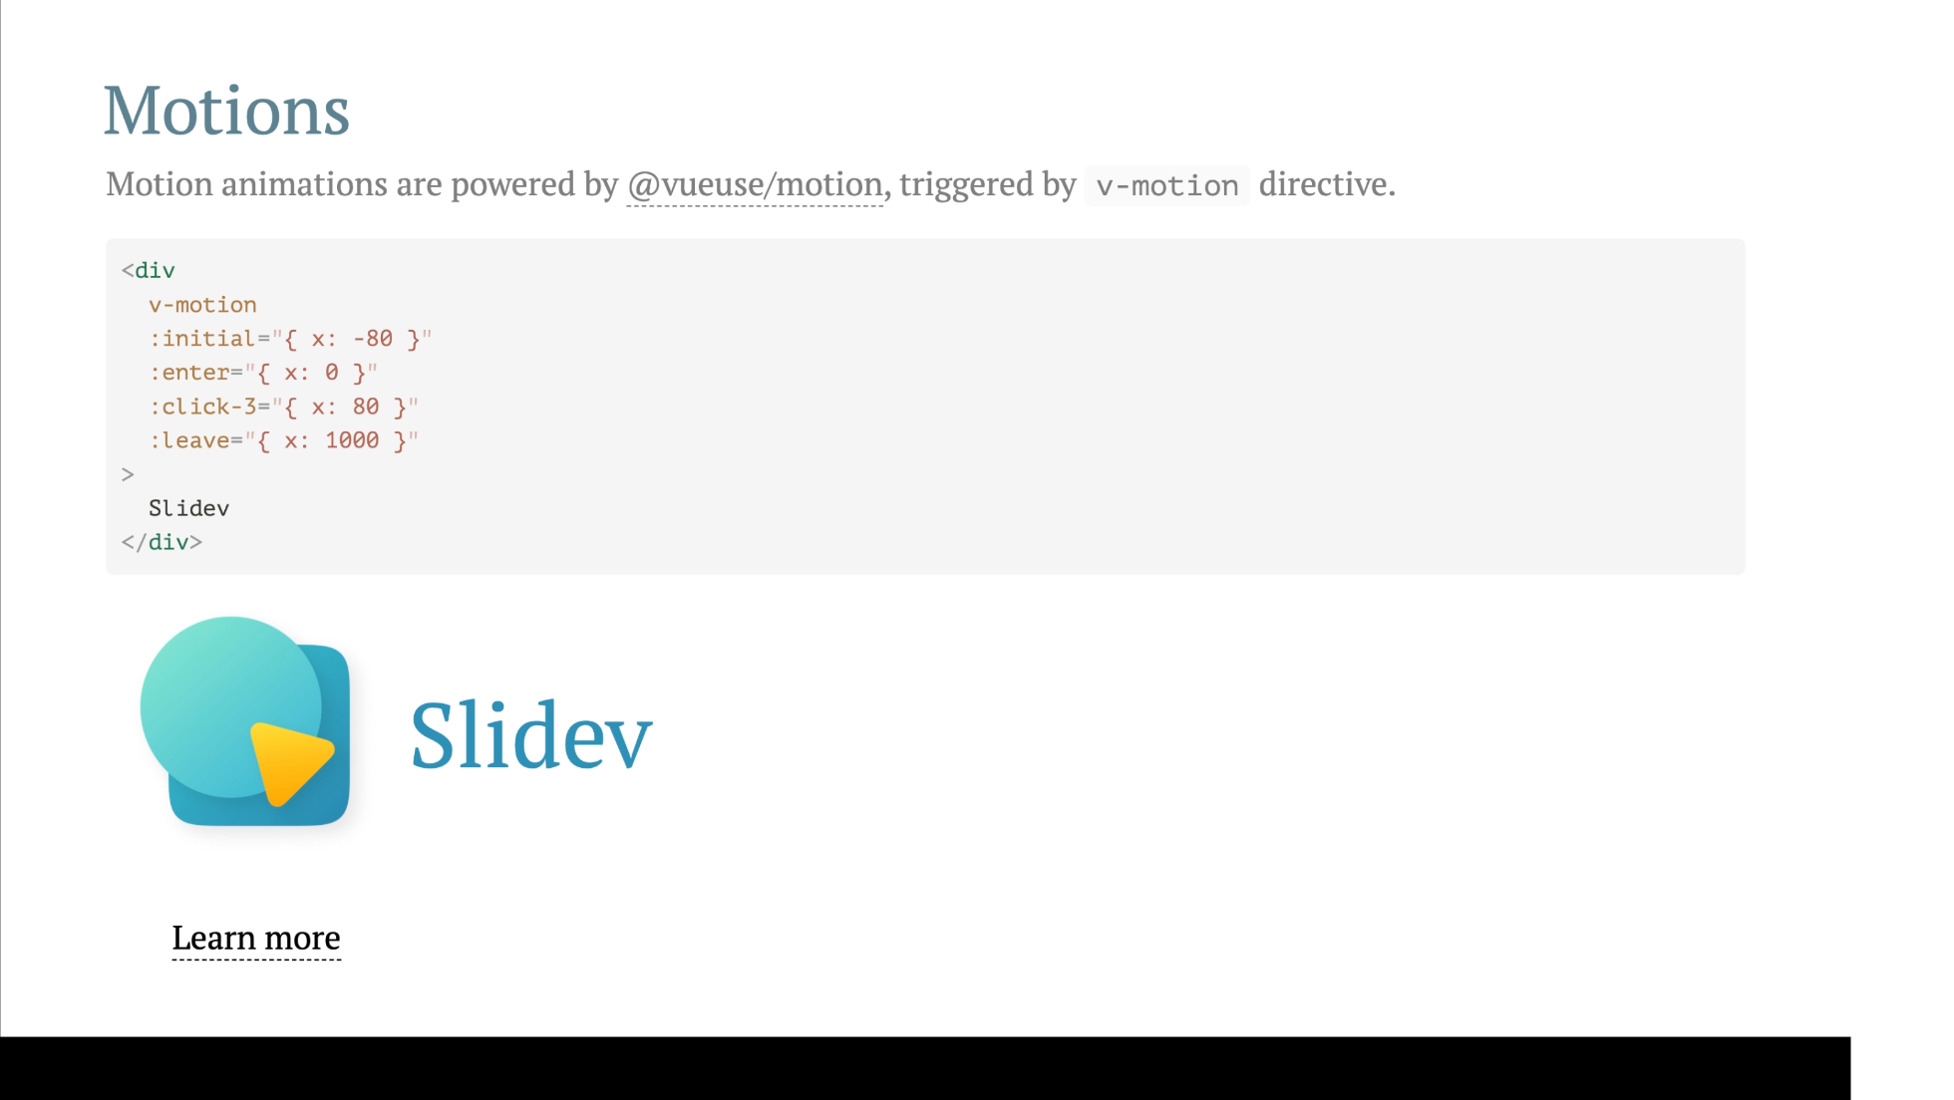

Slide 11
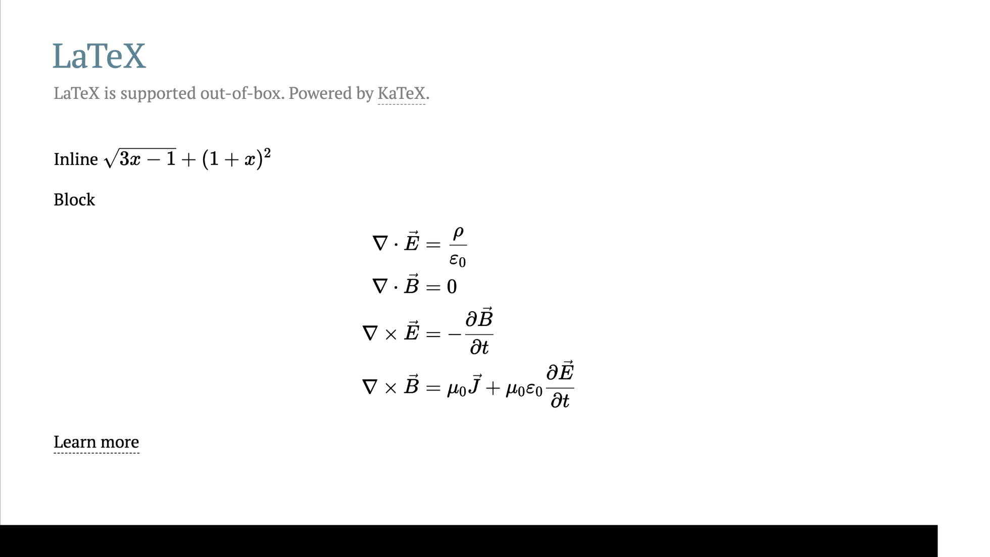

Slide 12
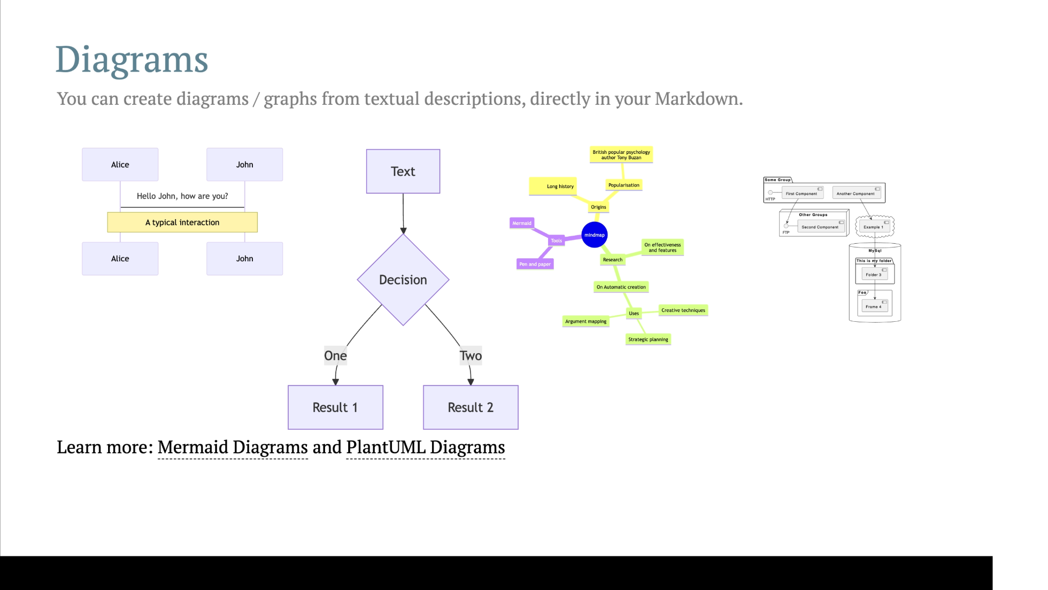

Slide 13
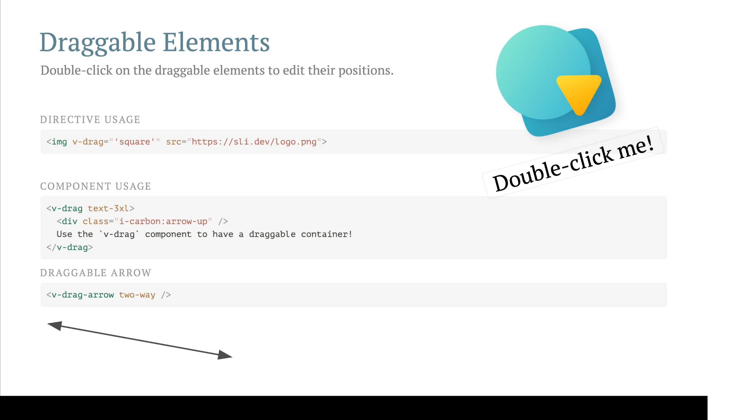

Slide 14
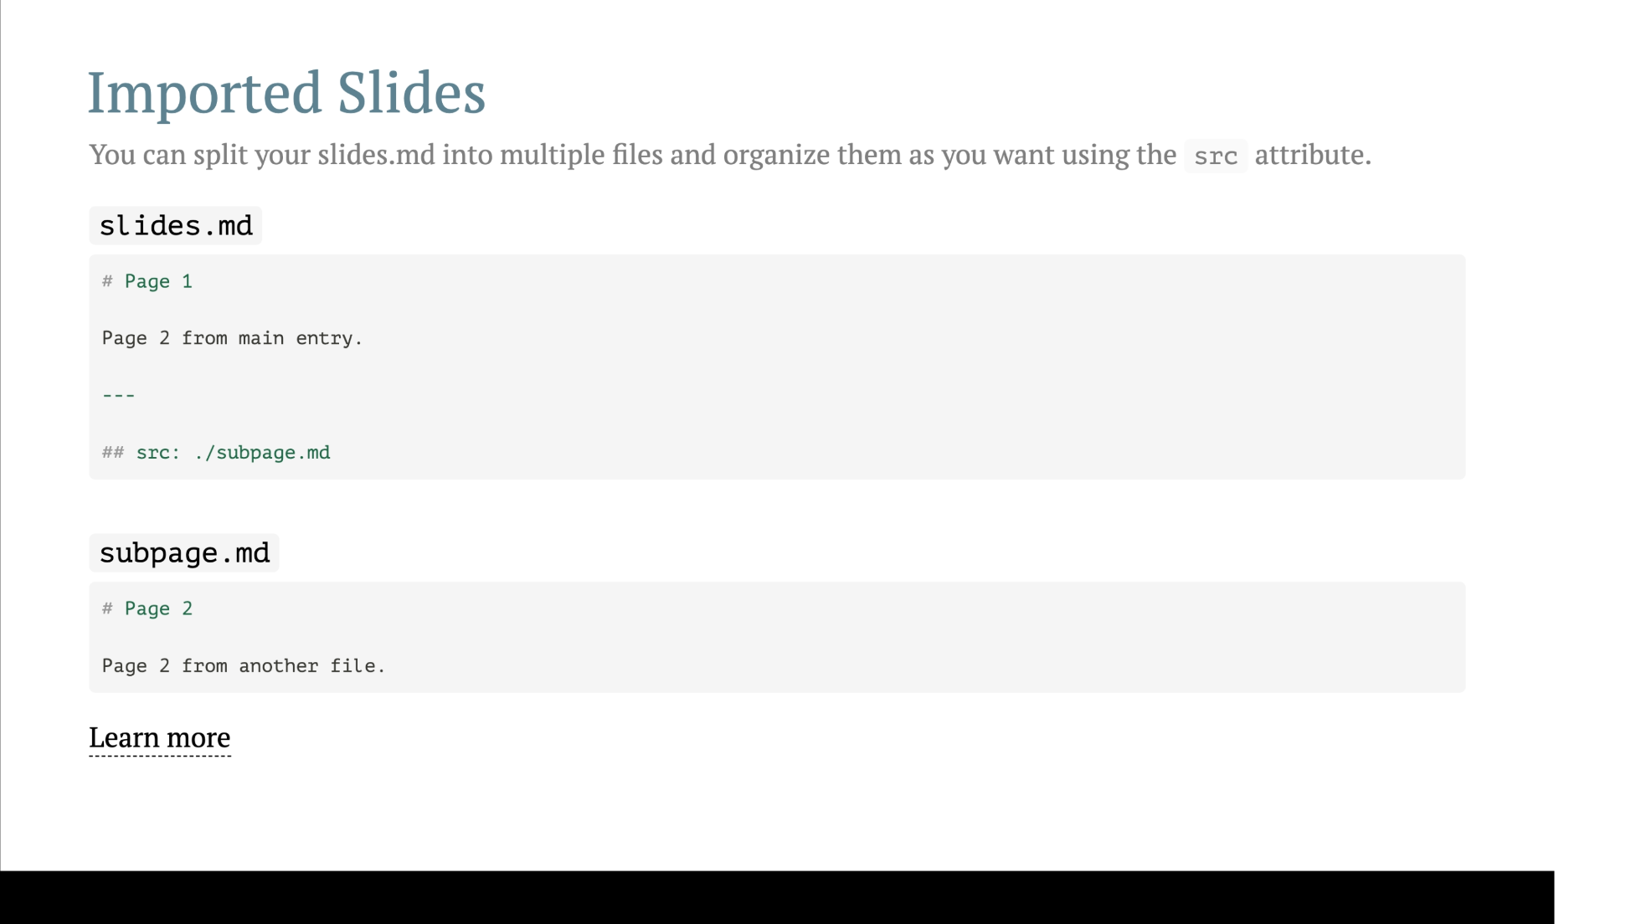

Slide 15
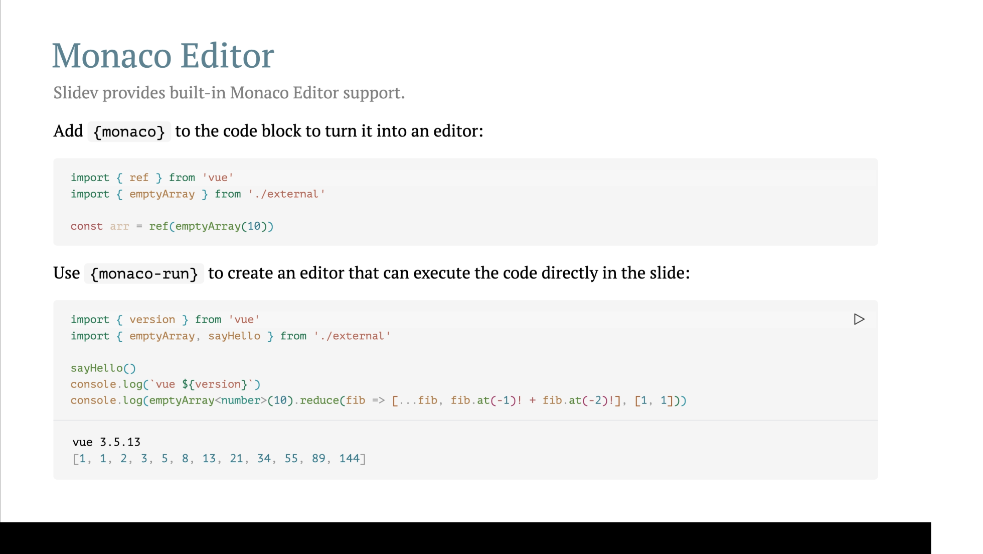

Slide 16


